Slide 1

Multi-Client FTP System
A comprehensive file transfer protocol system designed for concurrent client handling and robust file operations.
AVIK MANDAL
ANKIT KUMAR
NAVODIT VERMA
KAVY VAGHELA
UTKARSH KUMAR

Slide 2







Agenda
Project Overview
Core Principles & Architecture
Technical Implementation
Features & Demonstration
Applications & Future Enhancements

Slide 3

Project Overview
Multi-client FTP system
Client-server architecture
Enhanced Synchronization mechanisms
Concurrent file operations
Command line Interface

Slide 4





Core Principles
Robust File Transfer
Chunk-based protocol with error detection and retry mechanisms for failed transfers.
Concurrent Client Handling
POSIX threads for simultaneous connections and scalable
design for multiple clients
Command-based Interface
Simple text-based protocol supporting both local and remote operations.
Resource Management
Reader-Writer locks with deadlock prevention and fine
grained control over file access

Slide 5









Technologies Used
Multi-threading
Socket Programming
Mutexes & Condition Variables
Lock Timeout Mechanisms
Exponential Backoff

Slide 6




Architecture Overview
Client Component
Command interface
Local file operations
Server communication
Network Layer
Data transmission
Protocol handling
Server Component
Multi-threaded connection handling
File operation processing
Lock management

Slide 7








Synchronization Mechanism
Timeout Mechanisms
Prevents indefinite waiting
Deadlock Prevention
Detection and resolution strategies
Priority Management
Prevents reader/writer starvation
Reader-Writer Lock System
Multiple readers, exclusive writers

Slide 8










Thread Safety Mechanisms
Atomic Counters
Global Lock Registry
Thread Local Information
For statistics without contention
Protected by mutex for centralized management
For debugging and context tracking
Per-File Locks
Lock Cleanup
Fine-grained control for individual file access
Periodic maintenance of abandoned locks

Slide 9






Socket Communication
EOF Markers
Special markers for command output termination
Chunked Data Protocol
Size-prefixed chunks for file transfers
Reliable Data Transfer
Custom send_all/recv_all functions with guarantees
Our socket communication layer ensures data integrity through custom send_all and recv_all functions that guarantee complete data transmission even under network instability. The chunked data protocol efficiently handles file transfers by breaking data into manageable size-prefixed chunks. Special EOF markers clearly indicate command output termination, preventing ambiguity in communication streams.

Slide 10
Technical Implementation Details
// Server-side
void *handle_client(void *client_socket){
int sock = *(int *)client_socket;
string client_directory = ".";
// Handle Client code
}
// File Transfer
bool send_all(int sock, const void* buf, size_t len) {
const char* p = static_cast<const char*>(buf);
while (len > 0) {
int bytes = send(sock, p, len, 0);
if (bytes <= 0) return false;
p += bytes;
len -= bytes;
}
return true;
}
// Client-side
void send_command(int sock, string command){
char buffer[BUFFER_SIZE];
send(sock, command.c_str(), command.size(), 0);
// Send command code
}
// File Transfer
bool recv_all(int sock, void* buf, size_t len) {
char* p = static_cast<char*>(buf);
while (len > 0) {
int bytes = recv(sock, p, len, 0);
if (bytes <= 0) return false;
p += bytes;
len -= bytes;
}
return true;
}

Slide 11




Advanced Synchronization Features
Reader-Writer Fairness
Deadlock Prevention
Our system implements a balanced approach between readers and writers to prevent starvation, ensuring all operations get fair access to resources.
We employ timeout-based detection and global statistics monitoring to identify and prevent potential deadlocks before they occur.
Exponential Backoff
Smart retry mechanisms with increasing delays and jitter provide efficient resource utilization during high contention periods.

Slide 12

Lock Implementation Details
struct rwlock_t {
pthread_mutex_t mutex; // Basic lock for the structure
pthread_cond_t readers_cv; // For readers to wait
pthread_cond_t writers_cv; // For writers to wait
int readers_count; // Number of active readers
int writers_count; // Number of active writers
int waiting_writers; // Number of waiting writers
bool writer_active; // Is there an active writer?
unordered_map<string, bool> locked_files; // Track which files are currently being written to
unordered_map<string, int> file_readers; // Track number of readers per file
};

Slide 13
Server Implementation
Socket Creation and Binding
The server initializes by creating a socket and binding it to a specified port, preparing to accept incoming client connections.
Client Connection Handling
When clients connect, the server spawns dedicated threads to handle each connection independently, enabling multi-client support.
Command Processing
The server parses and executes commands received from clients, including file operations and directory navigation.
File Operation Handling
Implements directory listing (ls), permission changes (chmod), directory navigation (cd, pwd), and file transfers (put, get).
Lock Management
Coordinates access to shared resources through a sophisticated locking system to prevent conflicts.

Slide 14





Client Implementation
Server Connection
The client establishes a connection to the server using IP address and port number, creating a secure communication channel.
Command Interface
A user-friendly interface parses input and executes corresponding commands, translating user intentions into protocol operations.
Local File Operations
The client handles local operations (lls, lcd, lpwd, lchmod) without server interaction, improving efficiency for local-only tasks.
File Transfer
Implements put and get operations with sophisticated retry mechanisms to ensure reliable file transfers even under unstable conditions.

Slide 15
Core Features
Directory Navigation
Users can seamlessly navigate both local and remote directory structures with intuitive commands like cd, pwd, lcd, and lpwd.
File Management
Comprehensive file listing with format options and permission management provide complete control over file resources.
File Transfer
Robust upload and download capabilities with error checking and recovery mechanisms ensure data integrity during transfers.
Multi-Client Support
The server handles multiple simultaneous client connections, each in its own thread, allowing concurrent operations without interference.

Slide 16
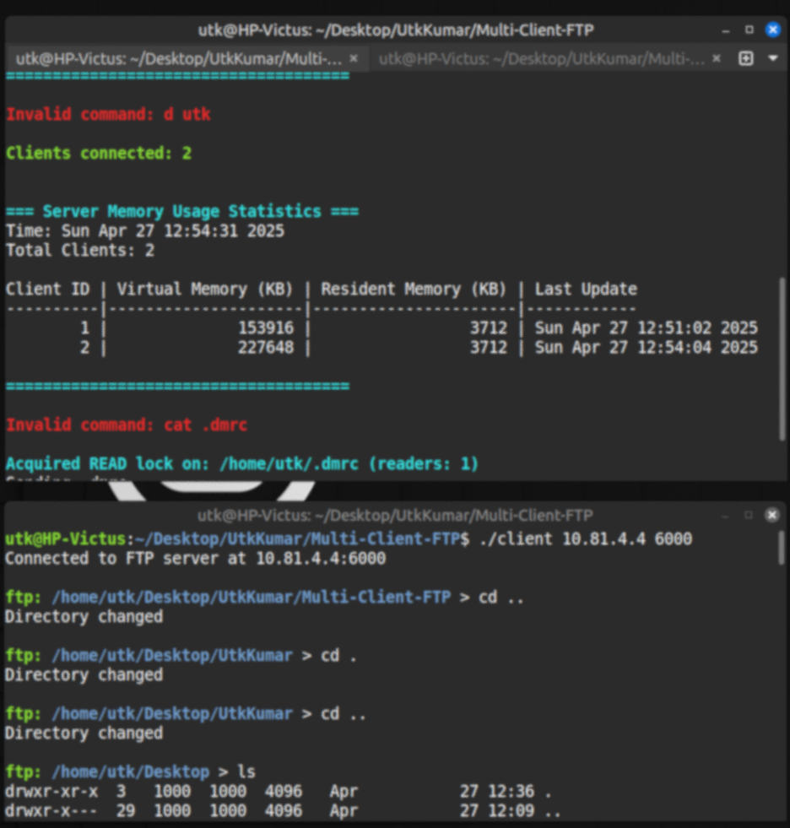




User Experience Features
Colorized Output
Detailed Error Messages
Enhanced readability through color-coded terminal output helps users quickly identify different types of information and status messages.
Clear, informative error messages guide users to understand and resolve issues quickly without requiring technical expertise.
Local and Remote Commands
Help System
Comprehensive documentation accessible directly from the command line offers immediate assistance for all available commands.
Intuitive command prefixing distinguishes between local and remote operations, providing a seamless experience across environments.

Slide 17
Demo: System in Action
Server Startup
$ ./server 8080 FTP Server started at 192.168.1.100:8080 ...
Client Connection
$ ./client 192.168.1.100 8080 Connected to FTP server at 192.168.1.100:8080
Remote Directory Listing
ftp: /home/user/server > ls drwxr-xr-x 4 user group 4.0 KB Jun 10 14:30 . drwxr-xr-x 8 user group 4.0 KB Jun 10 14:15 .. -rw-r--r-- 1 user group 10.5 KB Jun 10 14:20 file1.txt -rw-r--r-- 1 user group 2.3 MB Jun 10 14:25 file2.jpg
Local Directory Listing
ftp: /home/user/server > lls drwxr-xr-x 3 user group 4.0 KB Jun 10 14:40 . drwxr-xr-x 8 user group 4.0 KB Jun 10 14:15 .. -rw-r--r-- 1 user group 5.2 KB Jun 10 14:35 local_file.txt

Slide 18


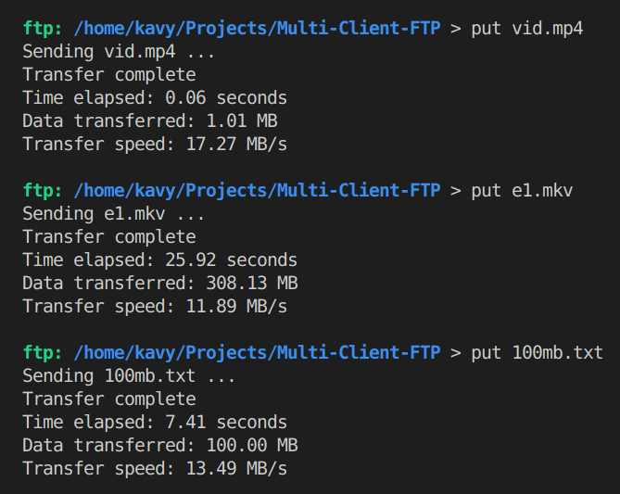
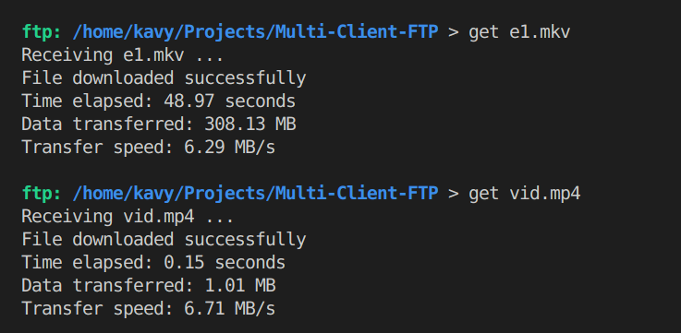
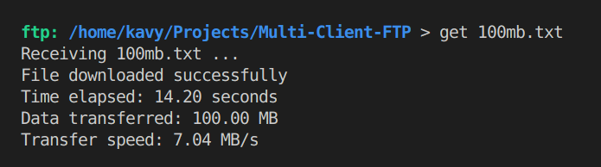
File Transfer Demos
Uploading a File
Downloading a File
Use put file.txt command to send files to server.
Use get file.txt to retrieve files from server.

Slide 19
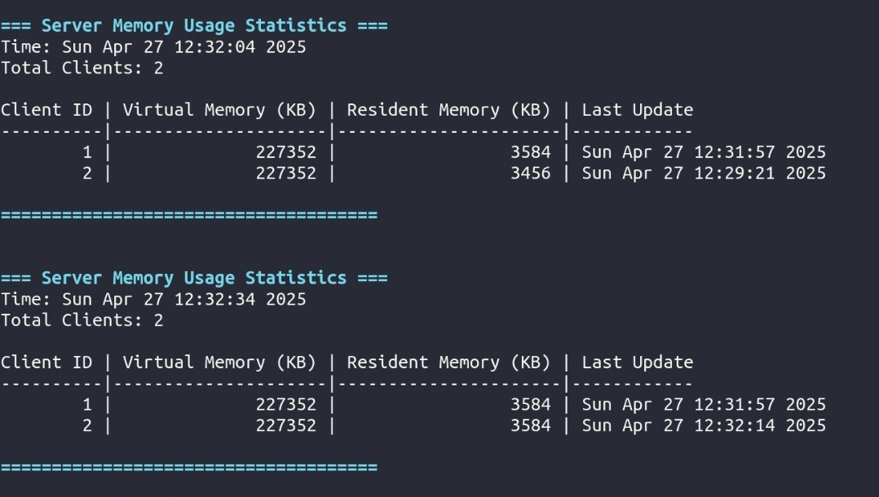
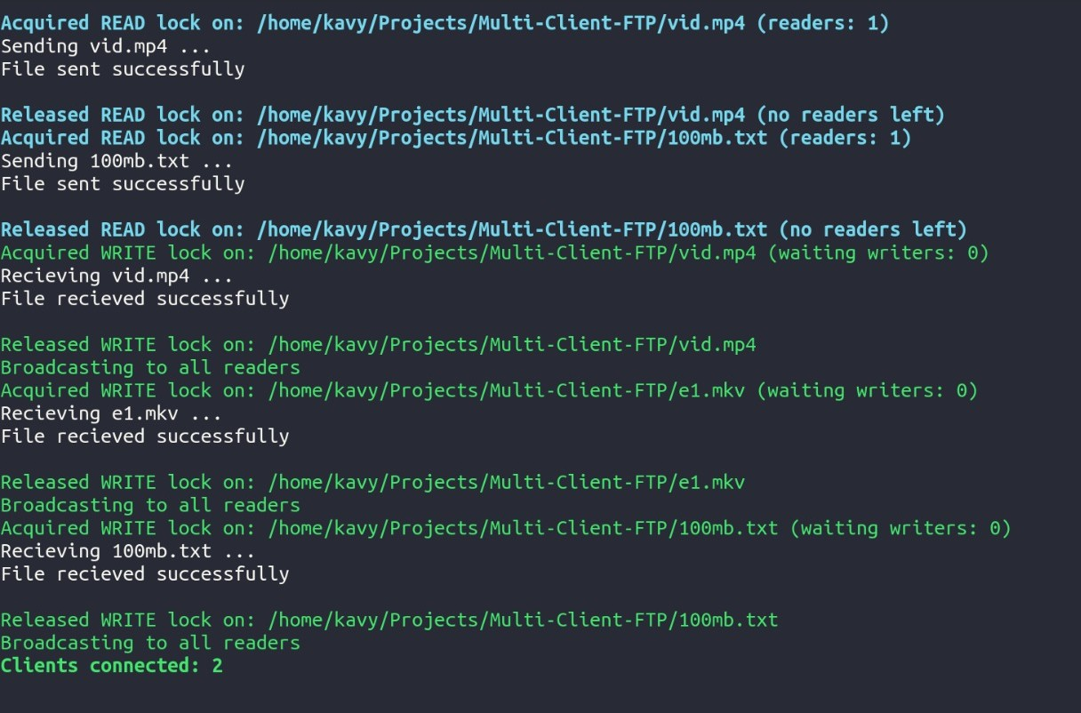
Server Snapshot
Reader Writer Lock
Memory Usage Stats

Slide 20






Real-World FTP Applications
Local Network Sharing
Simple file sharing in small office or home networks.
Backup Solutions
Reliable file transfers with retry for data safety.
Development Collaboration
Shared asset repository with file locking for teams.
Home Media Server
Media sharing across multiple devices effortlessly.
Educational Use
Assignment submission system for students and teachers.

Slide 21
Planned Future Enhancements
Security Enhancements
Performance Improvements
Feature Extensions
File append operations
User authentication and authorization
File caching for faster access
Directory synchronization
Parallel file transfers
Web-based management interface
Encrypted transfers (SSL/TLS)
Optimized lock management

Slide 22
Current System Limitations
No Authentication
Limited Encryption
Users lack identity verification, reducing security.
Data transfers are mostly unencrypted, vulnerable to attacks.
Local Network Focus
Basic File Operations
Designed for LAN use, limiting internet scalability.
Missing advanced operations like append or sync.
Resource Intensive
Manual Configuration
Performance suffers with many simultaneous clients.
Setup requires administrator hands-on work.

Slide 23
Conclusion
Robust multi-client FTP with sync
Demonstrated network and concurrency concepts
Implemented reader-writer locks and deadlock prevention
Comprehensive and extensible command interface
Foundation for future security and feature improvements

Slide 24
THANK YOU

